Slide 1
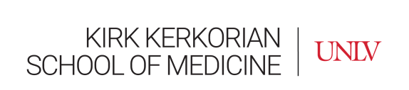

Moving Towards Whole Health and Health Equity:
Embedding Integrative Medicine & Whole Health Education in Medical School Curricula
Rashmi Mullur, MD
Clinical Professor of Medicine
Director of Integrative Medicine Education
Anne ”Annie” Weisman, Ph.D., M.P.H., L.M.T.
Director of Well-Being & Integrative Medicine
Associate Professor, Medical Education

Slide 2
Goals & Objectives
Recognize
Recognize the opportunities to embed integrative medicine education within standard medical curricula leveraging content in diversity, equity & inclusion.
Develop
Develop strategies to incorporate various pedagogical techniques into integrative medical curricula
Integrate
Integrate integrative medicine education from UME, to GME, with CME and including community education.

Slide 3
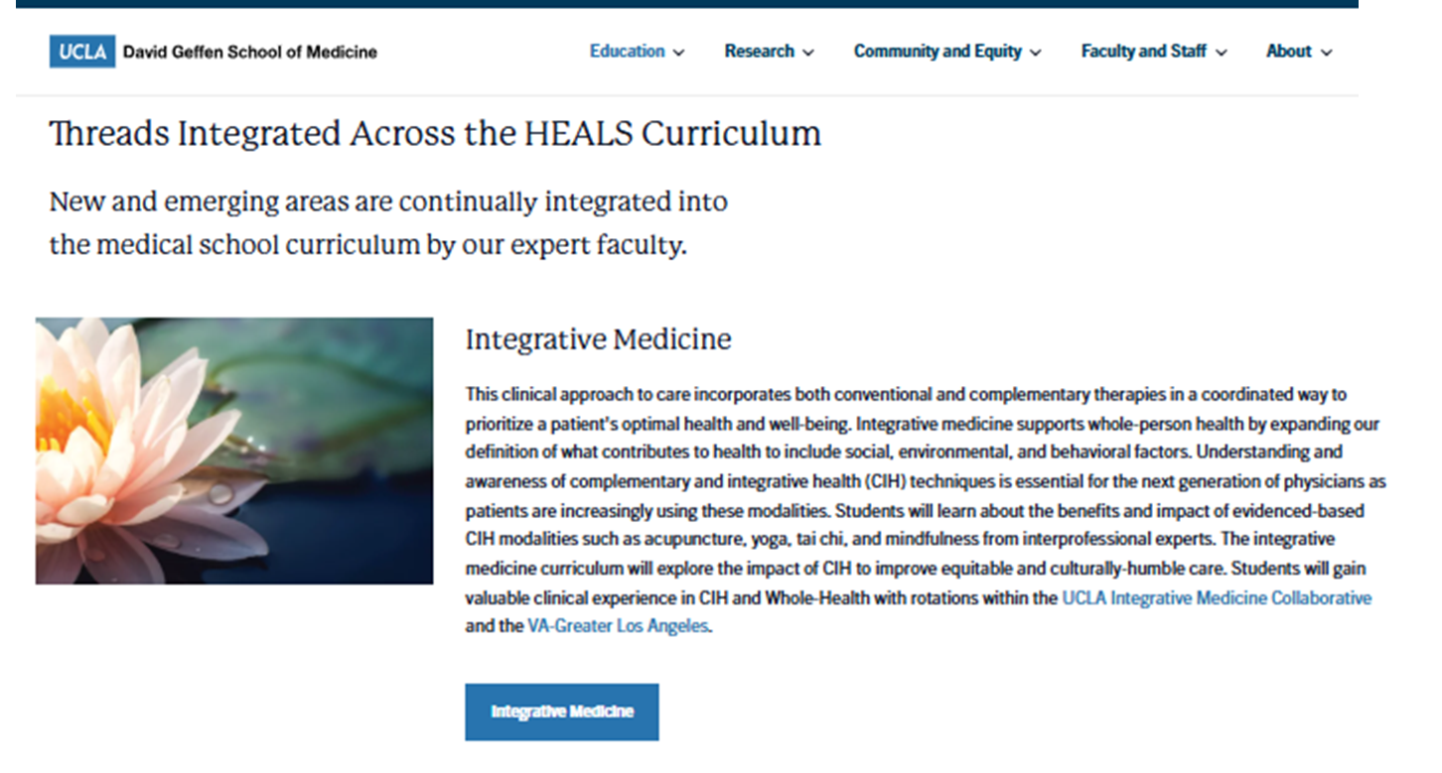
UCLA DGSOM HEALS Integrative Medicine Curriculum

Slide 4
Timeline of Integrative Medicine Educational Development at DGSOM at UCLA
2006
2018
2025
UCLA launches BLOCK Curriculum
ACIMH Faculty Development Grant Survey of DGSOM students re: CIH
UCLA Integrative Medicine Collaborative
Enhanced elective offerings in CIH
Graduating 1st Class of HEALS
CIH content expanded to clerkships and primary courses
The evolution of IM educational content at UCLA
2016
2021
CIH concepts introduced within a course in BLOCK curriculum
Launch of DGSOM HEALS
Integrative Medicine embedded within all 1st year courses

Slide 5
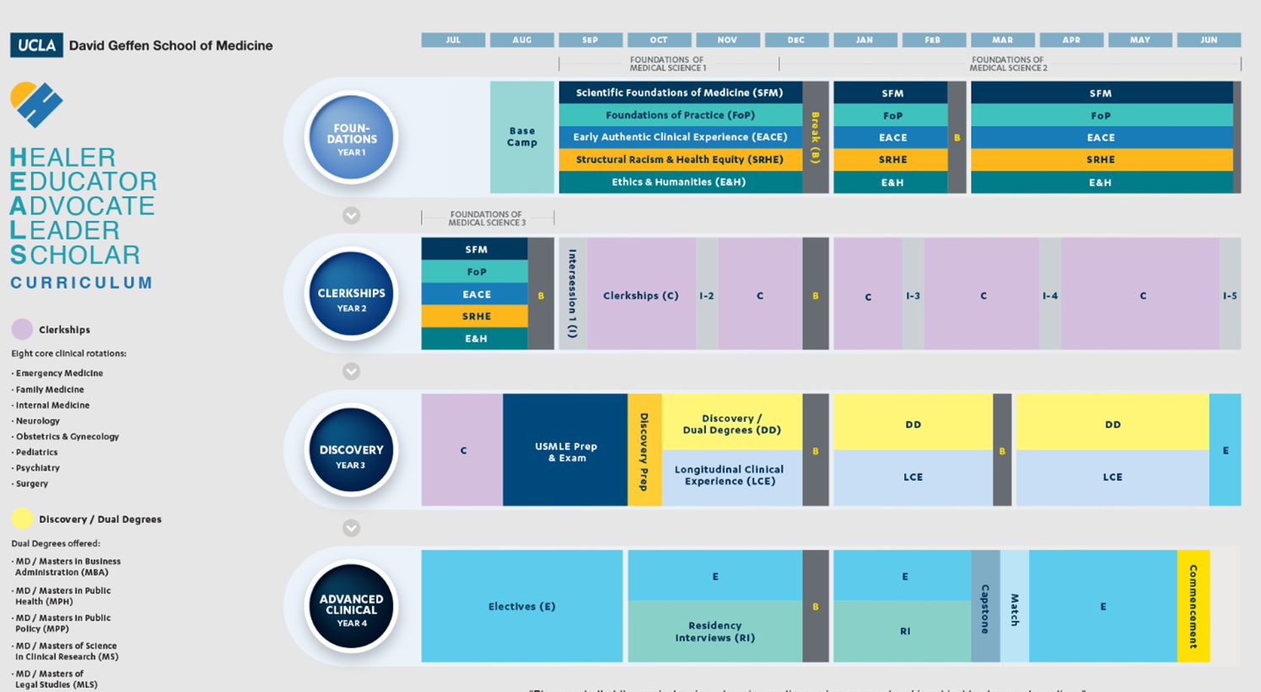
Embedded CIH & WH Content

Slide 6
Curricular Development: Strategies for Success
Deans’ Office Buy-In & Approval
  Development of 5 Core Learning Objectives in CIH mapped across curricula
  Alignment with DGSOM UCLA mission/values (Cultural North Star, Health Equity, Interprofessional Education, Social Justice/Advocacy)
Course Chair Engagement:
  Alignment with existing content
  Knowledge Assessment (formative & summative)
  Responsiveness to Course Evaluation & Feedback
Student Participation
  IM Interest Group(s): IM, Lifestyle Med, Music, Humanities, Wellbeing
  Extracurricular sessions & mentorship (across multiple subspecialties!!)
Employ Various Pedagogical Strategies & Session Types:
  Didactic, Case-Based, Standardized Patient, Experiential Workshops, Clinical

Slide 7
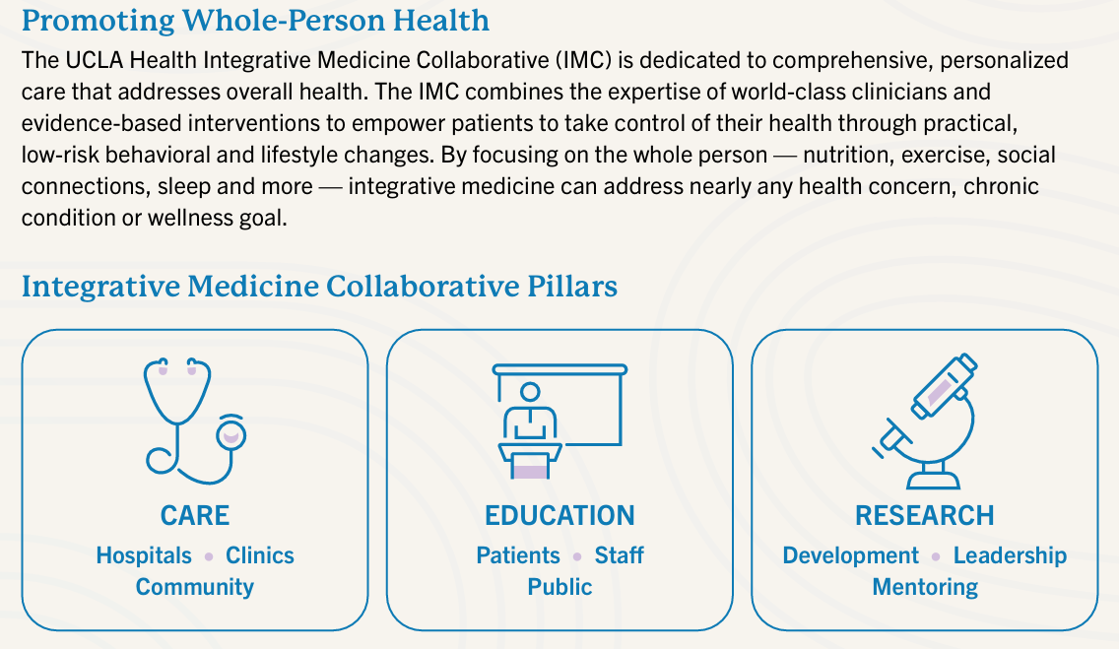
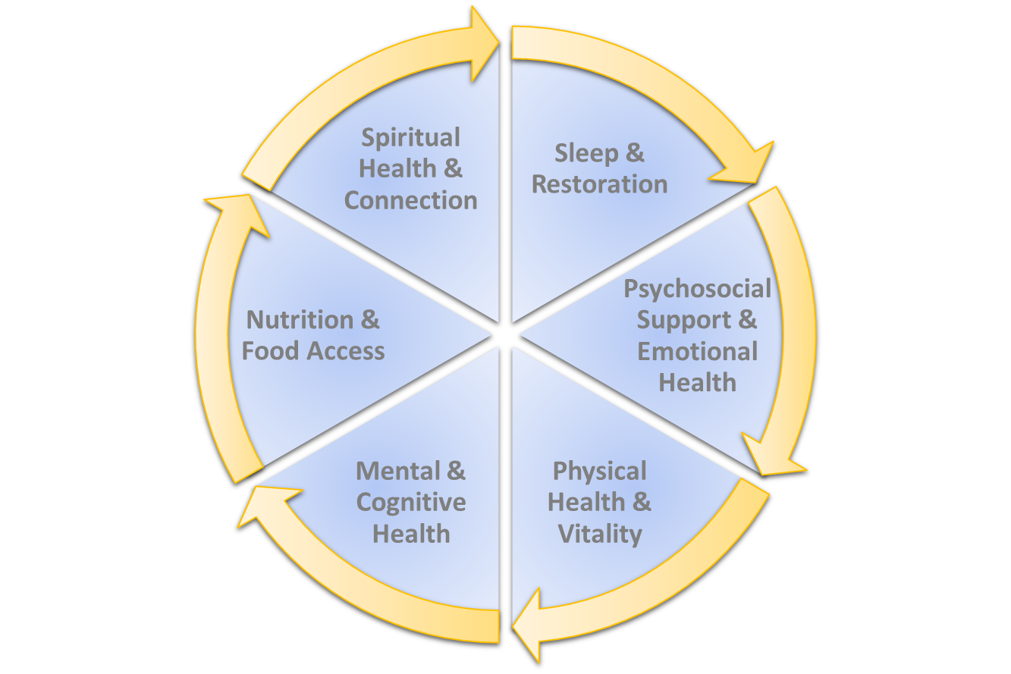
The Integrative Medicine Collaborative
UCLA Whole Health Model

Slide 8
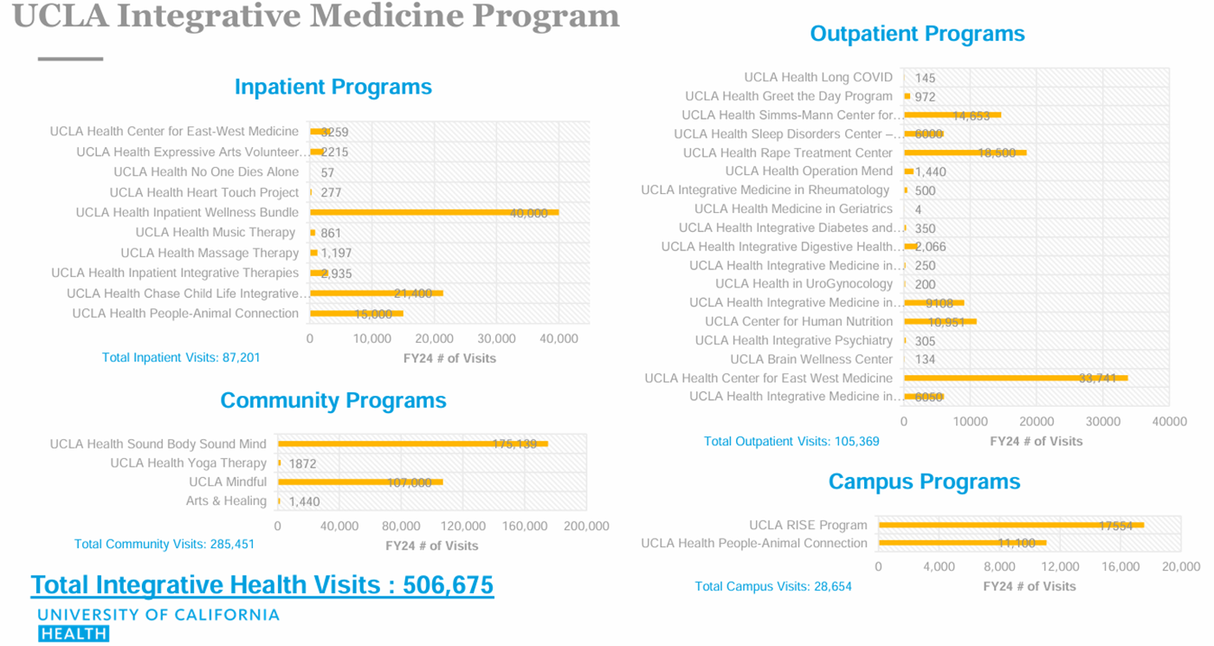

Slide 9
Bringing Whole Health Education into DGSOM at UCLA:
Teaches “The BioPsychoSocioSpiritual Model” in Clinical Practice
Models & Emphasizes Approaches for Self-Care & Resiliency for Students,Trainees & Staff
Aligns with Principles of Health Equity, Social Justice & Advocacy
Provides Opportunities for Interprofessional Education and Community Engagement
Medical School (UME)
Residency (GME)
Faculty (CME)
Foundational & embedded curricula for
all incoming medical students
Longitudinal content reinforced in clerkships & early clinical experiences—including at VA
Development of professional identity in WH/CIH & advocacy
Leverages VA-academic affiliation for WH training and clinical care
Creates specialty-specific career development pathways in WH
Provides faculty development in WH education & clinical care
Creates academic opportunities to engage students & residents

Slide 10
Questions about UCLA
Thank you!!

Slide 11
Moving Towards Whole Health & Health Equity:
Embedding Integrative Medicine into Medical School Curricula
Anne ”Annie” Weisman, Ph.D., M.P.H., L.M.T.
Director of Well-Being & Integrative Medicine
Associate Professor, Medical Education

Slide 12
Notes:
2017-2019 Curricular Map

Slide 13
Notes:
2020-2022 Curricular Map

Slide 15
Questions about UNLV
Thank you!

Slide 16
Panel Discussion Questions
How do our two different integrative medicine programs address whole person health?
How can other programs create these changes to include more WH and CIH in their programs?
Where are the openings in how we train students to see themselves as whole people, caring for whole people?

